Slide 1
Docker Storage

Slide 2
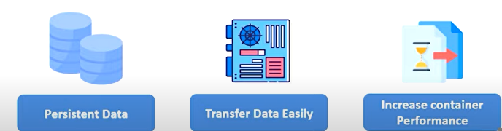
Docker Storage
Normally if you wanted to store data in Docker container it would be stored in the writable layer of the Docker container, but this is not an efficient way to store data.
So, we make use of different Docker storage types. These storage types have a lot of advantages over the default method like.

Slide 3
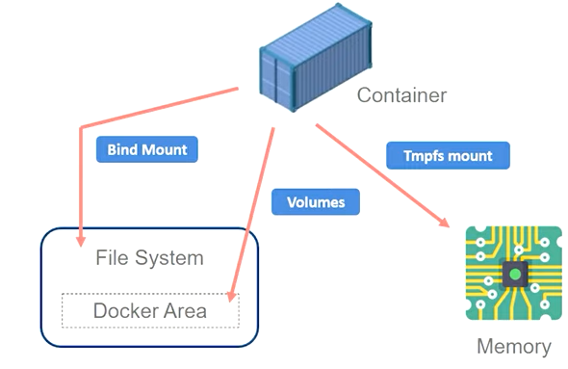
Types of Docker Storage
1. Volumes
2. Bind Mount
3. Tmpfs mount
Docker Area: /var/lib/docker/

Slide 4
1. Volumes
Docker volumes are basically persistent storage locations for the containers. They are managed by Docker completely. They can be easily attached and removed from containers. You can backup your Volumes also. This is most used type of data storage.
Common Commands:
Create docker volume.
~ sudo docker volume create <volume_name>
List docker volumes.
~ sudo docker volume ls
Inspect docker volumes.
~ sudo docker volume inspect <volume_name>
Delete docker volumes.
~ sudo docker volume rm <volume_name>
~ sudo docker volume prune (remove all volume at time)

Slide 5
1. Volumes
Attach volume to docker container.
~sudo docker run –it –d –-name <container_name> --mount source=<volume_name>,target=/apps
<image_name>
Ex. ~ sudo docker run –it –d –-name ConA --mount source=batman,target=/apps ubuntu
~ sudo docker run –it –d –name <container_name> --volume <volume_name>:/apps <image_name>
Ex. ~ sudo docker run –it –d –-name ConA --volume batman:/apps ubuntu
Ex. ~ sudo docker run –it –d –-name ConA –v batman:/apps nginx
Source: provide path of volume or name of volume if it is not already created then docker
will create new volume with given name and attached that to container.
Target: location inside container where you want to mount that volume ext. /apps
Note: Mount flag is generic flag which we can use along with Volumes, Bind mount and Tmpfs mount also.
However, volume flag we can use only with volumes.

Slide 6
1. Volumes
Attach volume to docker container as readonly.
~ sudo docker run –it –d –name <container_name> --mount source=<volume_name>,
target=/apps,readonly <image_name>
Example:
~ sudo docker run –it –d –name ConA --mount source=batman,target=/apps,readonly
ubuntu
~ sudo docker container inspect ConA

Slide 7
2. Bind Mount
Bind Mount’s aren’t managed by Docker and are mapped to a host system directory. The file or directory does not need to exist on the Docker host already. It is created on demand if it does not yet exist.
Common Commands:
Mount host directory to container using bind mount.
~ sudo docker run –it –d –-name ConA –-mount type=bind,source=/home/ubuntu/fun,
target=/apps ubuntu
~ sudo docker run –it –d –-name ConA –-mount type=bind,source=/home/ubuntu/fun,
target=/apps,readonly ubuntu

Slide 8
3. Tmpfs Mount
This type of storage maps to the Host system’s (Linux) memory. Tmpfs is not persistent like volumes and Bind Mount’s this will get removed when the container they are attached are stopped. They only ever get mapped to a single container in their lifetime. Allows you to store more temporary data without affecting a container efficiency.
Can used with Linux containers only.
Common Commands:
Mount Tmpfs to container.
~ sudo docker run –it –d –-name ConA –-mount type=tmpfs,target=/apps ubuntu

Slide 9
Storage Drivers
In situations where you must write in the Docker’s writable layer you can make use of specific storage drivers. These will allow you to maintain control over how docker images & containers are managed and stored.
Here are few examples of storage drivers.
Overlay2, aufs, devicemapper, btrfs, vfs

Slide 10
Thank You !

